Slide 1
EECT 111
Lab Notebook
By Charity Fischer
Spring 2018

Slide 2
Lab 1-Resistor Variability
Goal:
The goal of this lab was to familiarize oneself with resistors and their variability in particular
The tools used were 20 1kW resistors, a Digital Multimeter, and Excel for all calculations
My lab partner was Cory King and we used bench 6
The date was 2/1/2018

Slide 3
Lab 1-Resistor Variability
Procedure:
We selected 20 1kW resistors and
Measured each resistor with the Digital Multimeter by putting the input ends on each side of the resistor we were currently measuring
Calculated tolerance by cross multiplying

Slide 4
Lab 1-Resistor Variability
Results:
We found that the resistors varied greatly from one to the next and were never exactly as labeled.
The average of the resistance in our sample resistors was 994.67W
The smallest value was 978.2W
The largest valued resistor was 1002.9W, and
The standard deviation was 8.47W
The last thing to do was to calculate if the resistors exceeded their 5% tolerance and we found that they did not

Slide 5
Lab 1-Resistor Variability
Observations:
We found that though the resistors varied greatly from one to the next and were never exactly as labeled.
The sample resistors didn’t exceed resistance tolerance

Slide 6
Lab 2-Reading and Sorting Resistors
Goal:
The purpose of this lab was to learn how to read resistors using their color codes
The tools used were a Digital Multimeter, 15 resistors each at a different value from the other, and Excel to calculate tolerance
My lab partner was Cory King and we used bench 6
The date was 2/1/2018

Slide 7
Lab 2-Reading and Sorting Resistors
 | Color Code | Measured Value
100= | br, bl, br | 98.75
220= | r, r, br | 216.89
330= | o, o, br | 323.72
470= | y, v, br | 458.87
1k= | br, bl, r | 980
2.2k= | r, r, r | 2196.6
3.3k= | o, o, r | 3214
4.7k= | y, v, r | 4701
10k= | br, bl, o | 9776
22k= | r, r, o | 21625
33k= | o, o, o | 32815
47k= | y, v, o | 46872
100k= | br, bl, y | 99080
1M= | br, bl, gr | 1006000
10M= | br, bl, blue | 10610000
Procedure:
We selected 15 resistors ranging from 100W to 10MW
Measured each resistor with the Digital Multimeter by putting the input ends on each side of the resistor we were currently measuring

Slide 8
Lab 2-Reading and Sorting Resistors
Observations:
We found, with the exception of the 10MW resistor, that the difference between the resistor’s color code value and actual value stayed well within 5%
We also began to be able to recognize the value of a given resistor by reading the color code after handling them for a prolonged amount of time

Slide 9
Lab 3-Series Resistors
Goal:
The purpose of this lab was to experiment with series circuits and verify that the simulation, Excel analysis and lab test results all agreed
The tools used were a Digital Multimeter, an Elvis II, 3 resistors of different values(2.2kW, 4.7kW, 10kW), and Excel
My lab partner was Salem Aldossary and we used bench 6
The date was 2/8/2018

Slide 10
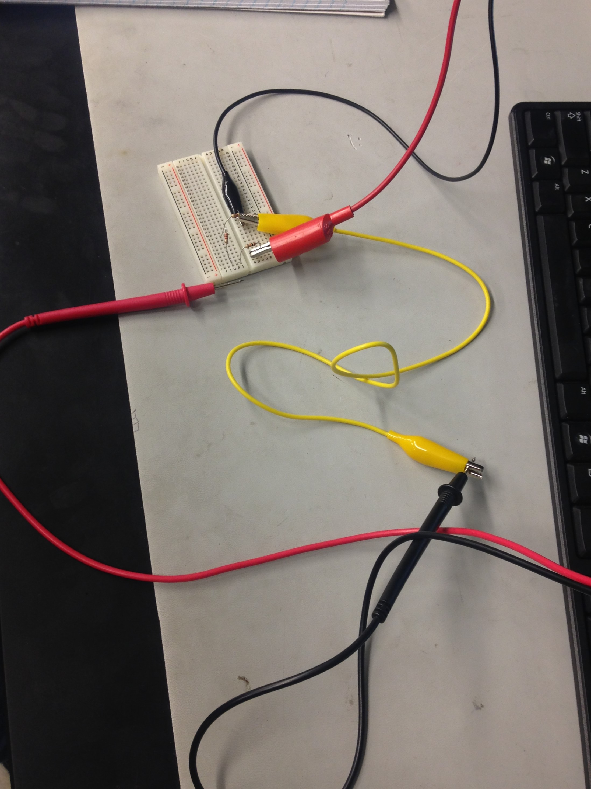
Lab 3-Series Resistors
Procedure:
We measured all 3 resistors to find exact value and put them into Excel to calculate the circuit resistance by finding the sum
We put them into the breadboard according to the lab then hooked up the Digital Multimeter and the Elvis II as shown in the picture beside this text
We set the Elvis II to 9V and recorded our findings while moving the positive input end of the digital Multimeter to find VA and VB

Slide 11
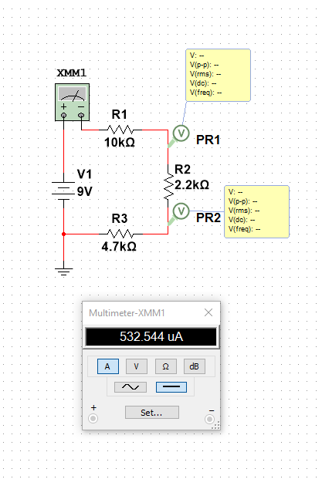
Lab 3-Series Resistors
Procedure:
We attached the Multimeter to our physical circuit much like the circuit that was simulated beforehand in the picture beside to find the current of the circuit
We clipped the negative alligator clip of the Elvis II to one side of our series resistors then attatched the positive side to the positive input end of the Multimeter
We then attached the alligator clips of a ground cable to the other side of the circuit and the other input end of the Multimeter
This gave us the current of our circuit

Slide 12
Lab 3-Series Resistors
Results:
The results are as follows on the Excel spreadsheet we made that day
The measured is what was done in the lab
The calculated is what was done through Excel, and
The simulated is what was done in Multisim
 | Measured | Calculated | Simulated
R₁ = | 9.809E+3 | 10.0E+3 | 10.0E+3
R₂ = | 2.193E+3 | 2.2E+3 | 2.2E+3
R₃ = | 4.701E+3 | 4.7E+3 | 4.7E+3
V₁ = | 9 | 9 | 9
R_{t} = | 16.702E+3 | 16.9E+3 | 16.9E+3
I_{t} = | 503.390E-6 | 532.5E-6 | 532.544E-6
V_{a} = | 3.6615 | 3.6746 | 3.67
V_{b} = | 2.4861 | 2.503 | 2.5

Slide 13
Lab 3-Series Resistors
Observations:
The simulated and the calculated results were incredibly close to each other while the measured varied
This was most likely due to the real-world variability of the resistors, but it did not fall outside of reason

Slide 14
Lab 4-Series Black Box Design
Goal:
The purpose of this lab was to learn about series circuits by designing a series circuit whose current was 10mA with 9V of applied DC voltage and had 3 standard resistors
The tools used were a Digital Multimeter, an Elvis II, 3 standard resistors (100W, 330W, 470W), and Excel
My lab partner was Salem Aldossary and we used bench 6
The date was 2/15/2018

Slide 15
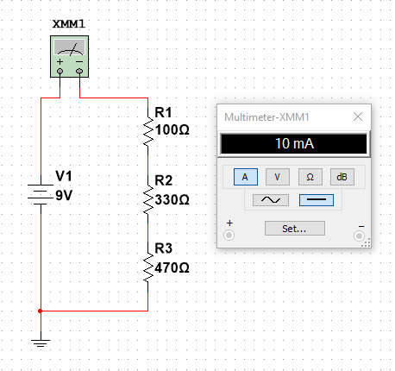
Lab 4-Series Black Box Design
Procedure:
First I had to determine what 3 standard resistors we should use to create a series circuit whose current was 10mA with 9V of applied DC voltage. I discovered this by first finding the total resistance using R=V/I.
Then I found 3 resistors whose sum equals V/I.
I then put my selected resistor values into Multisim to verify that this circuit would indeed create the desired outcome of 10mA

Slide 16
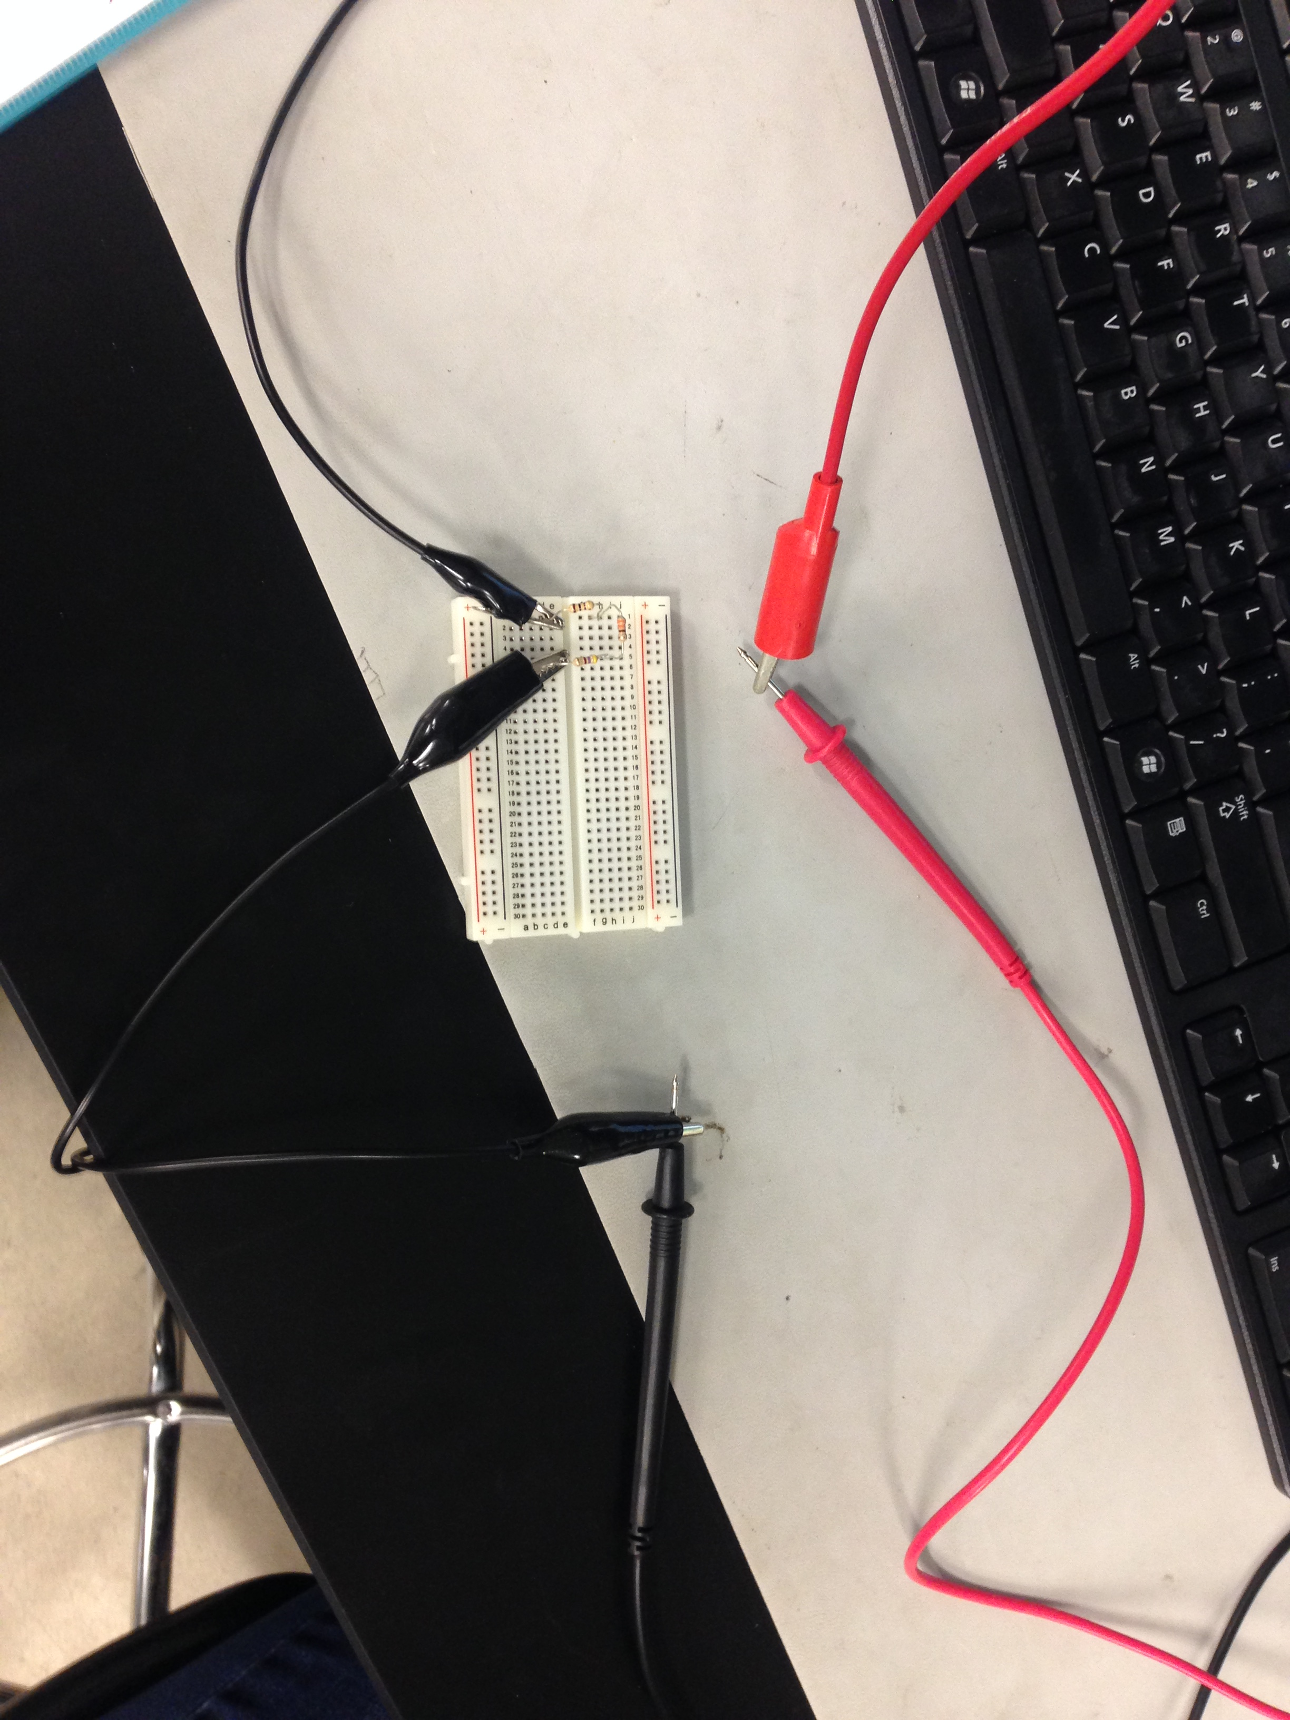
Lab 4-Series Black Box Design
Procedure:
Once in the lab, my lab partner and I selected the 3 resistor values that we needed and measured the value of each one
We then used the breadboard to make our circuit and then hooked up the Elvis II and Digital Multimeter as displayed in the picture beside
When attached this way the Multimeter gave us the measure of the current in our circuit

Slide 17
Lab 4-Series Black Box Design
 | Design | Measured | Calculated | Simulated
V1= | 9 | 9 | 9 | 9
It= | 10.0E-3 | 9.835E-3 | 10.0E-3 | 10.0E-3
Rt= | 900 | 915.0991 | 900 | 900
R1= | 100 | 98.11 |  | 100
R2= | 330 | 326.47 |  | 330
R3= | 470 | 471.1 |  | 470
Rt= | 900 | 895.68 |  | 900
Results and observations:
We found that our measured results matched up very near to what we had calculated and simulated beforehand
I observed that there will always be a difference between what’s measured in real life and what is simulated and calculated in a computer

Slide 18
Lab 5-Pressure Sensor
Goal:
The purpose of this lab was to learn about variable resistors and a Weatstone Bridge
The tools used were a Digital Multimeter, a pressure sensor model kit, and 3 large washers
My lab partner was Salem Aldossary and we used bench 6
The date was 3/8/2018

Slide 19
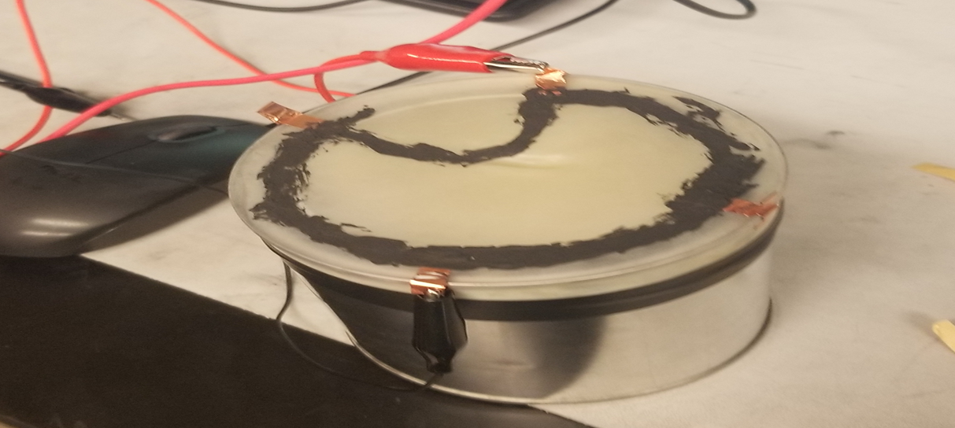
Lab 5-Pressure Sensor
Procedure:
First we used a paint can and a rubber balloon to make a drum-like structure before taping it securely with electrical tape
Then we made a paste with the equivalent of 15 sticks of graphite leads and 3 ml of rubber cement
Following a template that was given to us we used drew a pacman-esque shape on the top of the drum that had four bits of conductive copper tape at opposite sides of the drum

Slide 20
Lab 5-Pressure Sensor
Procedure and Results:
When the paste was dried we attached the Digital Multimeter to the drum to read the resistance this was R1
We then added one washer for each of the following resistance readings making the reading for R4 under the weight of three washers
 | Measured
R1 = | 6.6k
R2 = | 6.5k
R3 = | 6.4k
R4 = | 6.2k

Slide 21
Lab 5-Pressure Sensor
Observations:
The bigger the area that the makeshift resistor covered the less resistance it had

Slide 22
Lab 6-Parallel Black Box Design
Goal:
The purpose of this lab was to learn about parallel circuits by designing a parallel circuit whose current was 18mA with 9 of applied DC voltage and had 2 standard resistors
The tools used were a Digital Multimeter, an Elvis II, 2 standard resistors (1kW, 1kW), Multisim, and Excel
My lab partner was Salem Aldossary and we used bench 6
The date was 2/15/2018

Slide 23
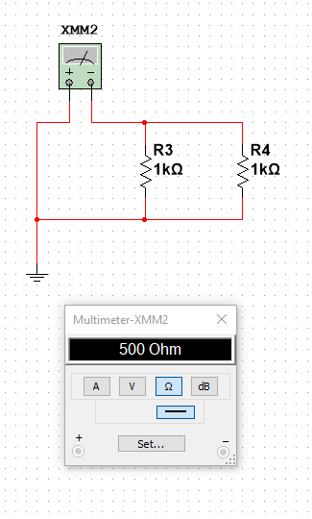
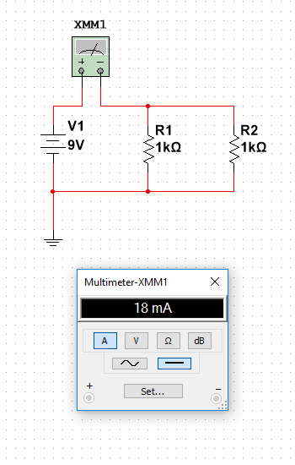
Lab 6-Parallel Black Box Design
Procedure:
First I had to determine what 2 standard resistors we should use to create a parallel circuit whose current was 18mA with 9V of applied DC voltage. To determine this I mostly just made a two resistor DC circuit in Multisim and guessed.
I found that 2 1kW resistors gave the desired total resistance of 500W
Once I had done that I was able to make a proper circuit in Multisim with a DC battery to once again verify that the current would be 18mA

Slide 24
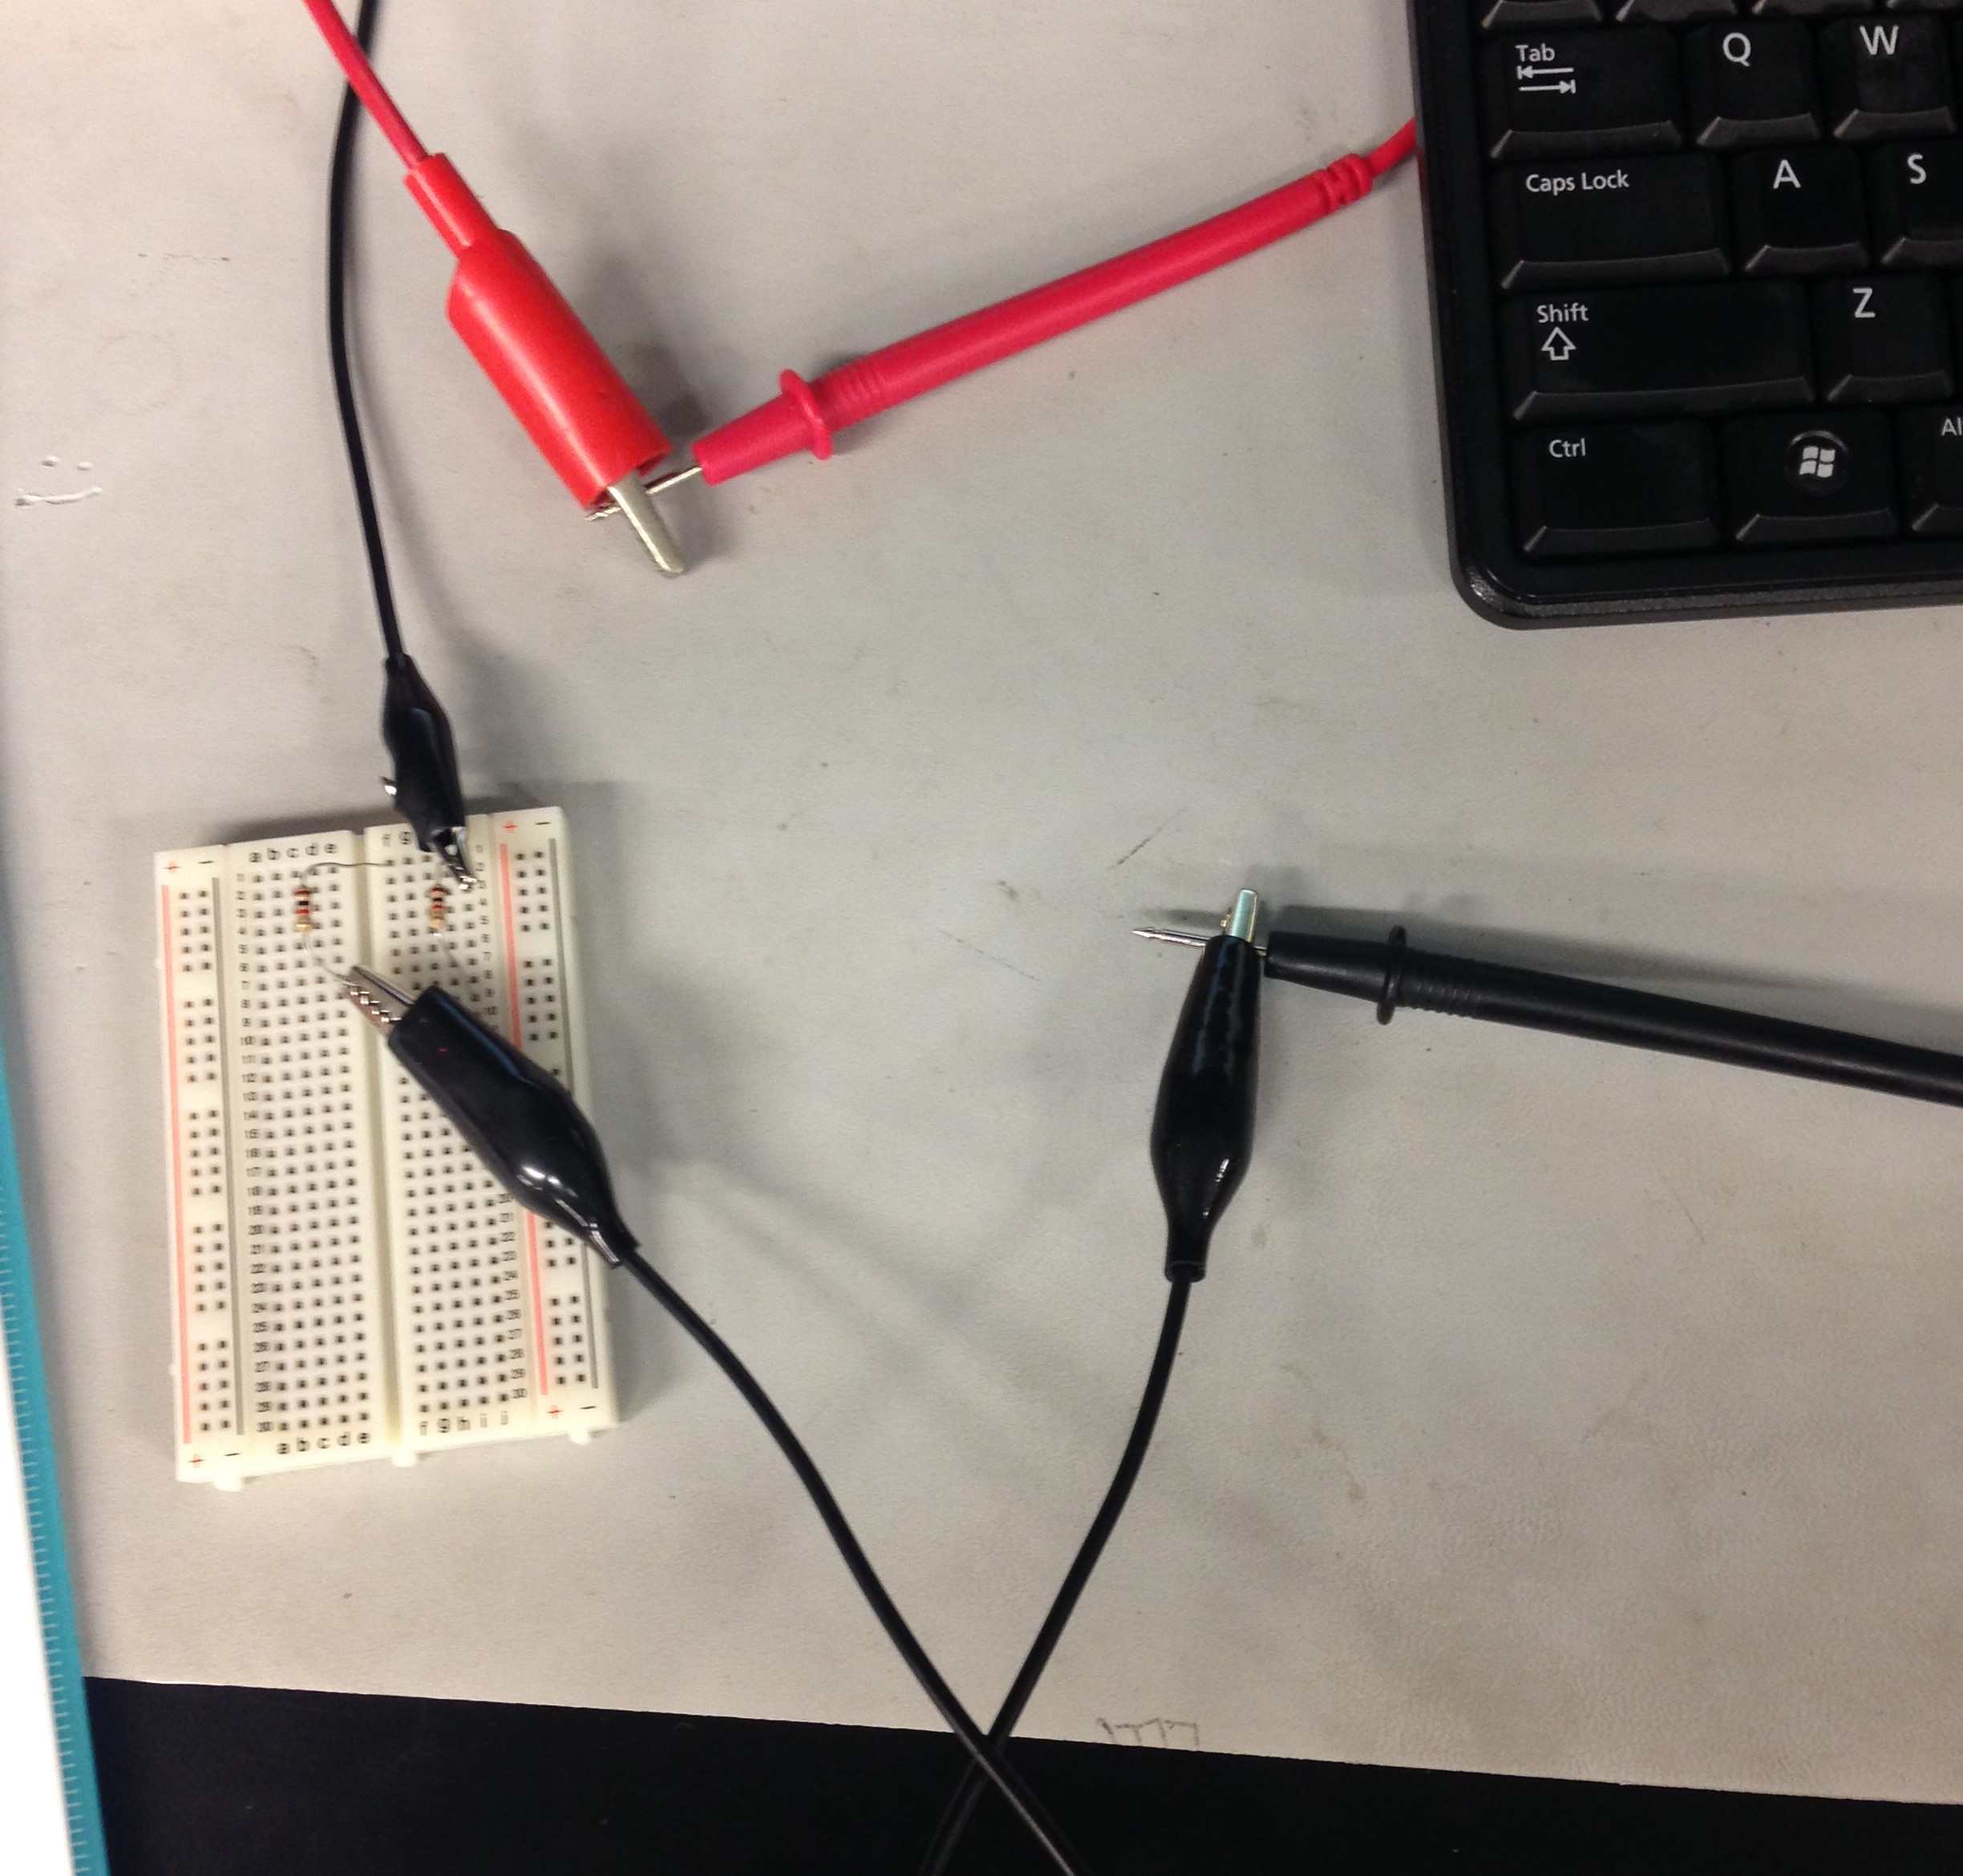
Lab 6-Parallel Black Box Design
Procedure:
In the lab my lab partner and I selected 2 1kW resistors and put them into the breadboard in a parallel form
We then hooked up the Elvis II and the Multimeter using a ground to measure the circuit’s current

Slide 25
Lab 6-Parallel Black Box Design
 | Design | Measured | Calculated | Simulated
V= | 9 | 9 | 9 | 9
It= | 18.0E-3 | 17.412E-3 | 18.0E-3 | 18.0E-3
Rt= | 500 | 500.3 | 500 | 500
R1= | 1.0E+3 | 1000.7 | 1.0E+3 | 1.0E+3
R2= | 1.0E+3 | 1000.1 | 1.0E+3 | 1.0E+3
Results and Observations:
We found that our measured results matched up very near to what we had calculated and simulated beforehand
I also noted that the higher the resistance the lower the current as can be extrapolated from R=V/I

Slide 26
Lab 7-Resistor Parallel Circuit
Goal:
The purpose of this lab was to learn more about parallel circuit by making one and measuring total current and all branch currents
The tools used were a Digital Multimeter, an Elvis II, 4 standard resistors (2.2kW, 3.3kW, 4.7kW, 4.7kW), Multisim, and Excel
My lab partner was Salem Aldossary and we used bench 6
The date was 2/22/2018

Slide 27

Lab 7-Resistor Parallel Circuit
Procedure:
First I made an Excel sheet to determine what the resistivity is of the circuit is using the 4 resistor values prescribed. I calculated this using the reciprocal method $Rt=(\frac{1}{\begin{aligned}\frac{1}{rs}+\frac{1}{r2}+\frac{1}{r3}+…1/rn \\ \end{aligned}})$
I then calculated the total current by dividing the voltage (which here is 9V) by the total resistance
After that I went on to calculate the current after each resistor by dividing the voltage (9) by the resistor that the current had just passed through

Slide 28
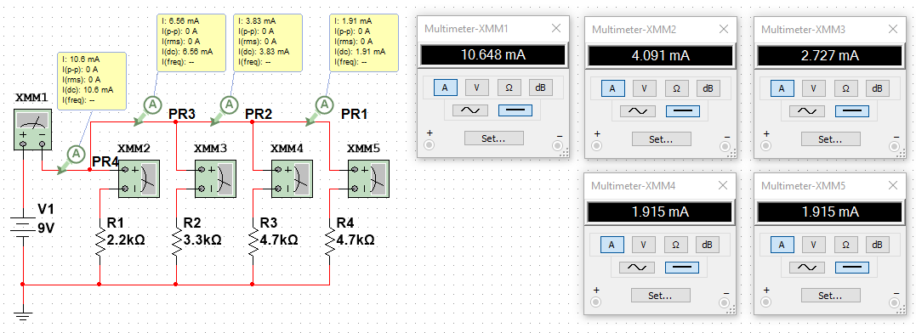
Lab 7-Resistor Parallel Circuit
Procedure:
I used Multisim to verify all the following current values I had calculated

Slide 29
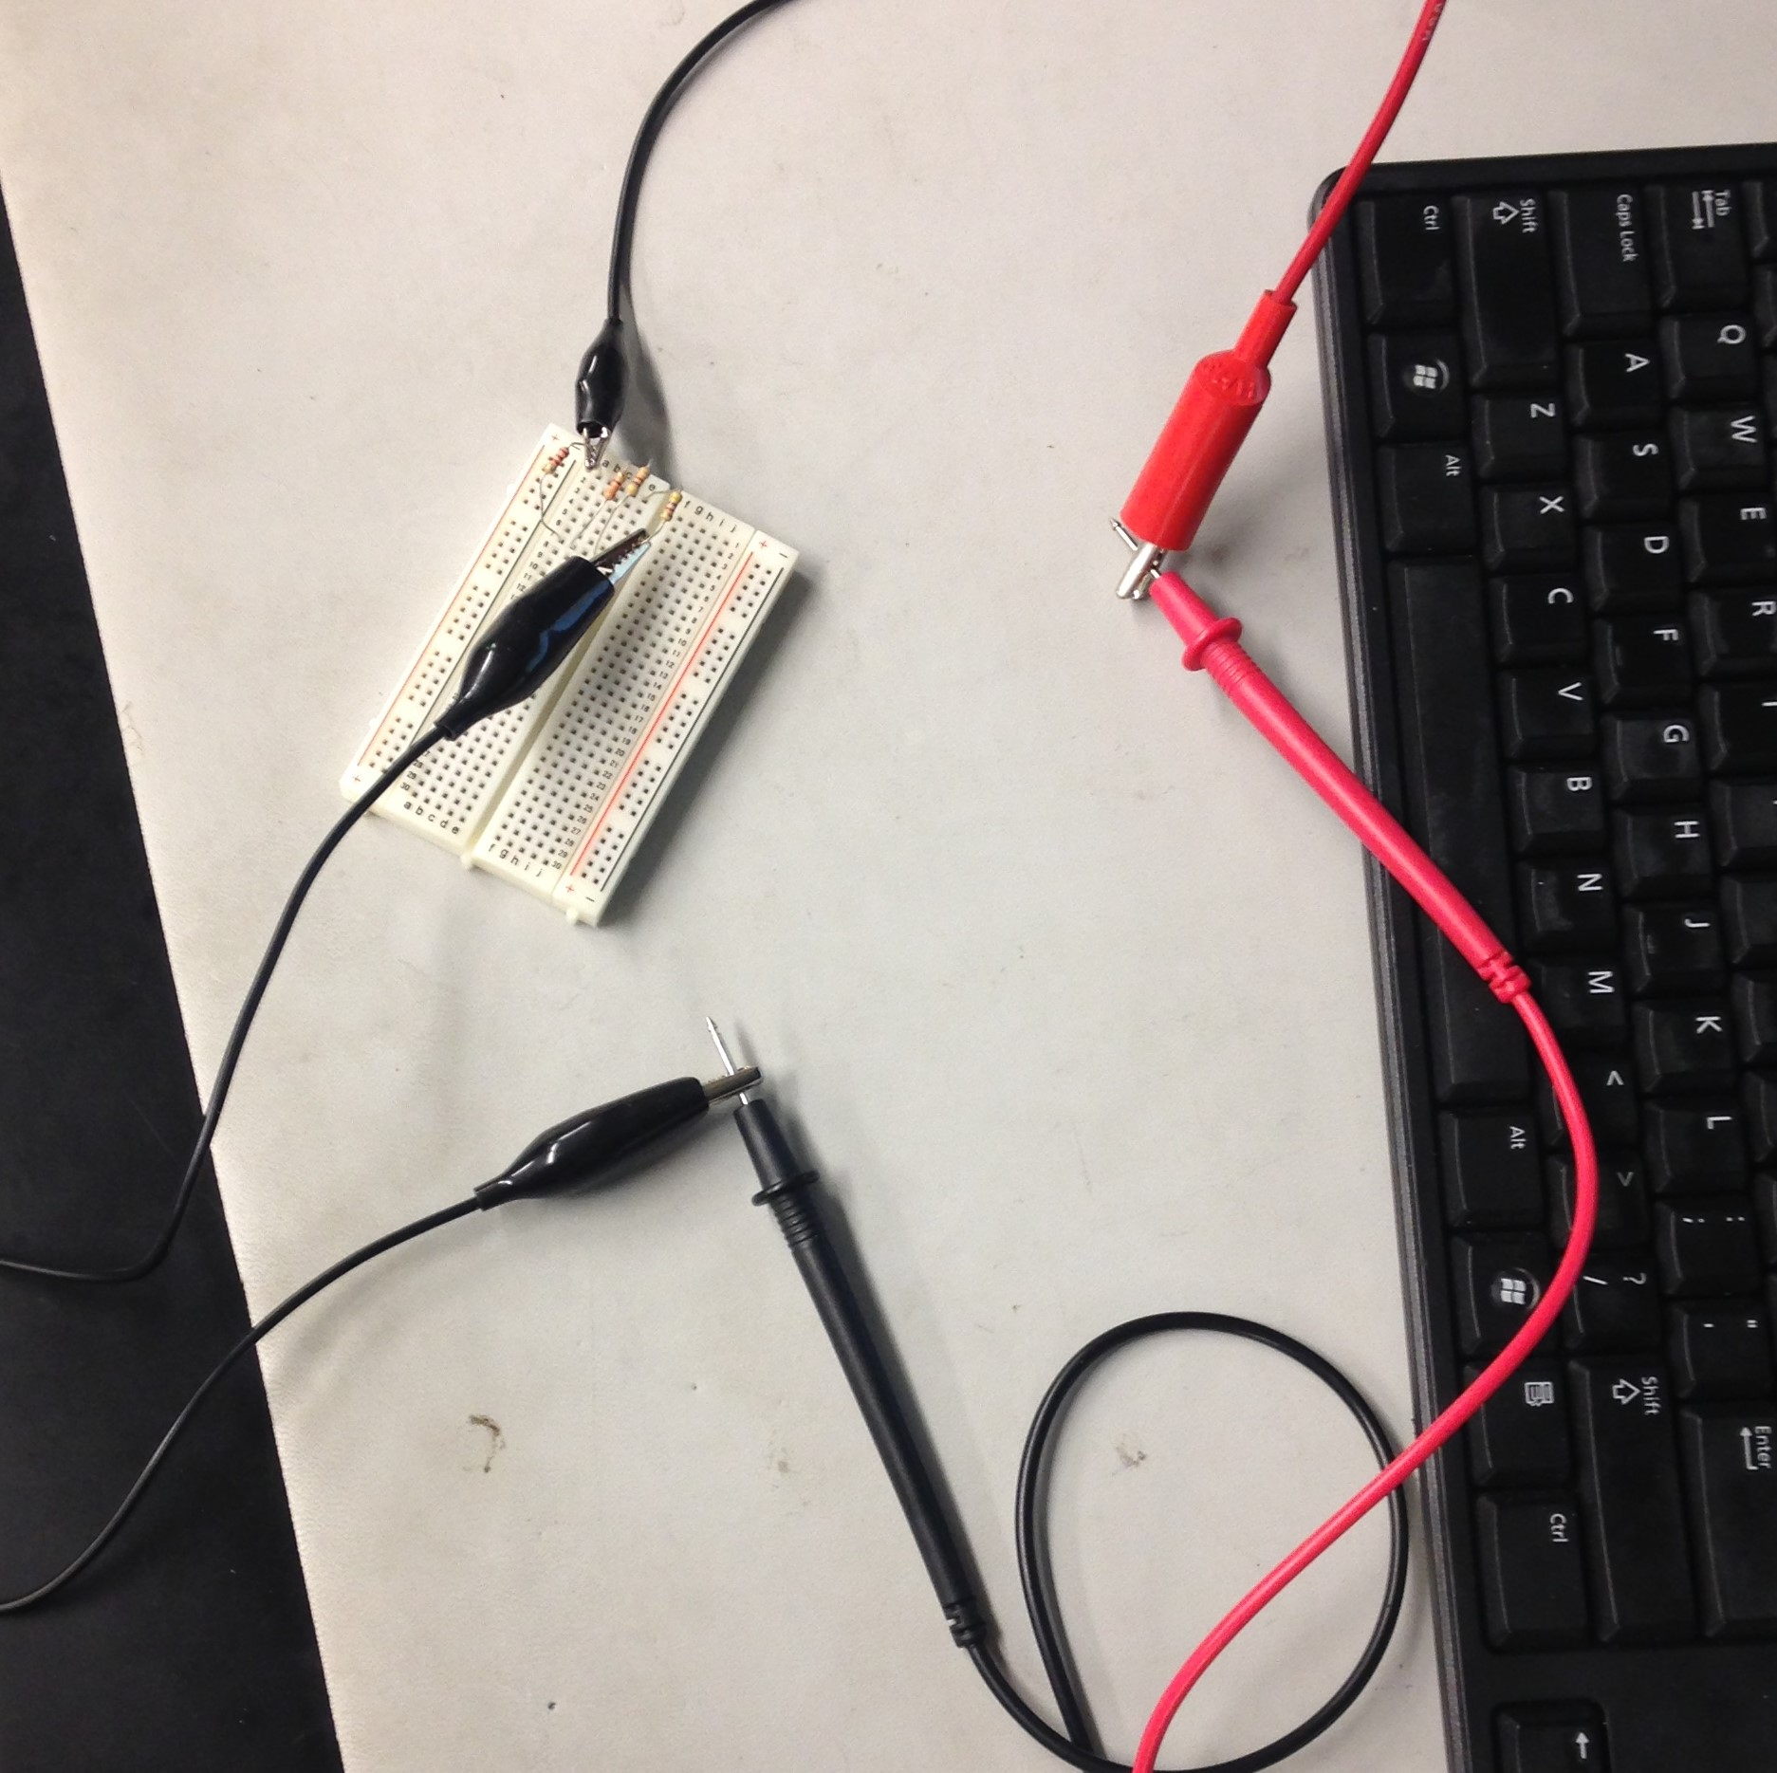
Lab 7-Resistor Parallel Circuit
Procedure:
When we had measured all the resistors to be used and recorded them in Excel Salem and I
Attached the negative clamp of the Elvis II to one side of the circuit
Attached the positive clamp of the Elvis II to the positive input end of the Multimeter
Attached the negative input end to an alligator clip that was then attached to the opposite side of the circuit as the Elvis II negative clamp

Slide 30
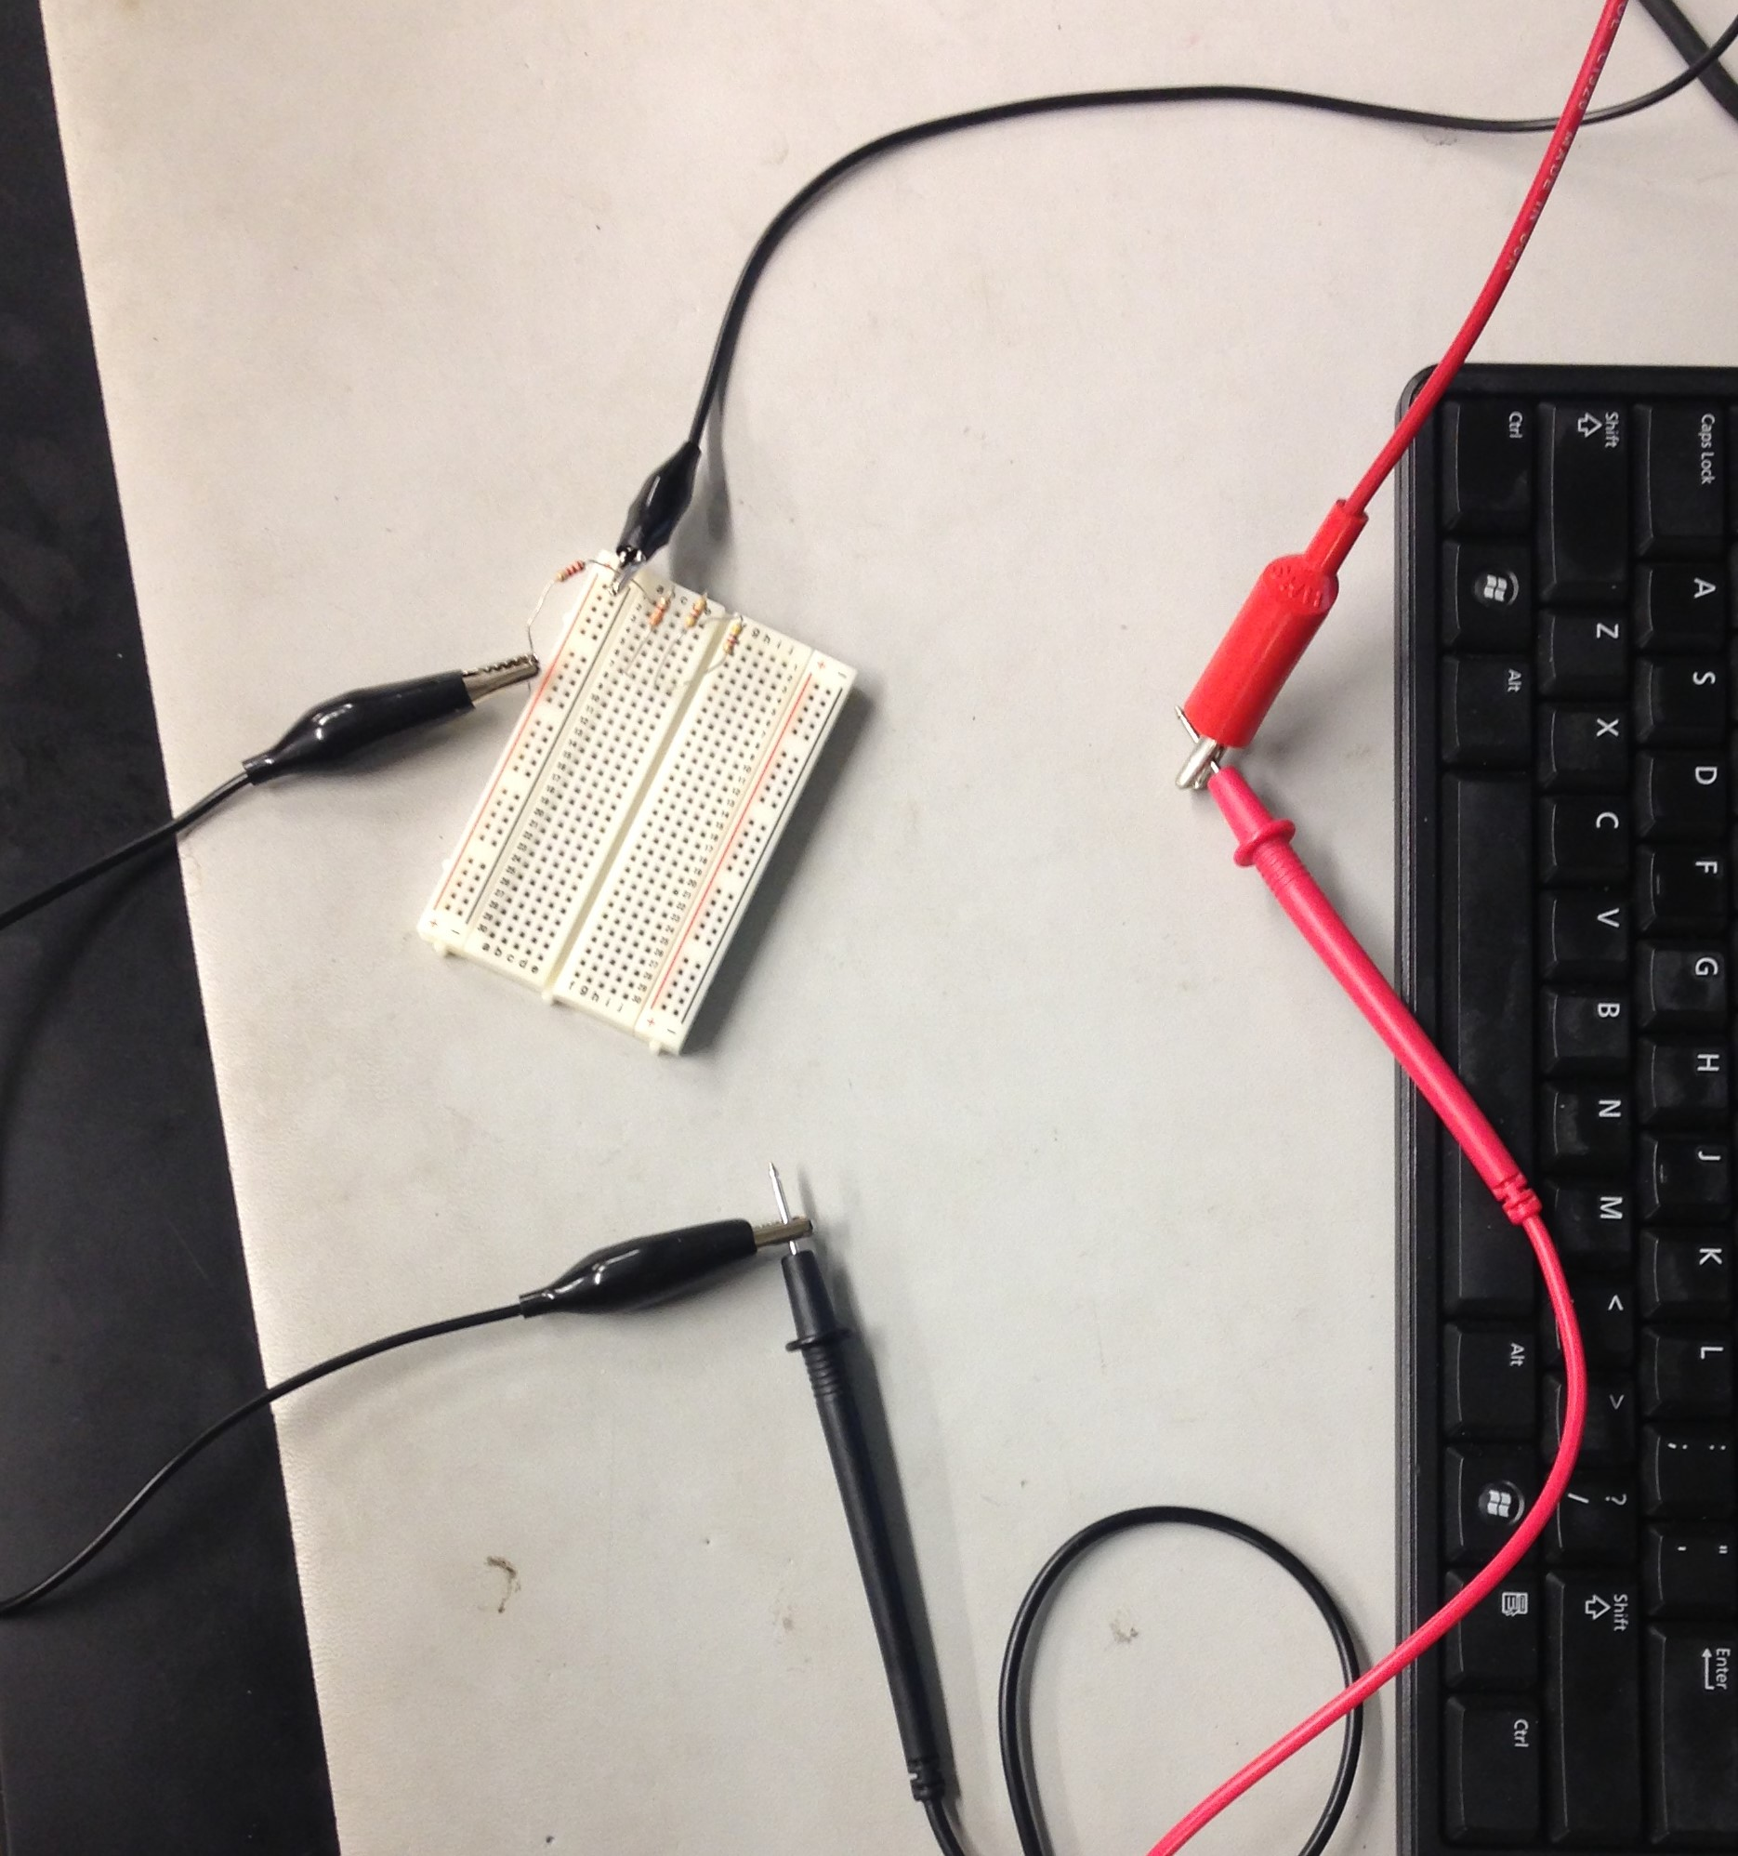
Lab 7-Resistor Parallel Circuit
Procedure:
To find the current at each resistor we only had to make a small modification to the configuration we had just made with the Multimeter, Elvis II, circuit board, and the alligator clips
We moved the alligator clip from where was on the circuit and put it on the first resistor then pulled the resistor from the breadboard
We did this for each successive resistor in the parallel circuit

Slide 31
Lab 7-Resistor Parallel Circuit
 | Measured | Calculated | Simulated
V1 = | 9 | 9 | 9
R1 = | 2.18E+3 | 2.2E+3 | 2.2E+3
R2 = | 3.29E+3 | 3.3E+3 | 3.3E+3
R3 = | 4.59E+3 | 4.7E+3 | 4.7E+3
R4 = | 4.73E+3 | 4.7E+3 | 4.7E+3
Rt = | 839.4 | 845.2316 | 845.232
It = | 10.49E-3 | 10.6E-3 | 10.6E-3
I1 = | 3.908E-3 | 4.09E-3 | 4.1E-3
I2 = | 2.628E-3 | 2.73E-3 | 2.7E-3
I3 = | 1.903E-3 | 1.91E-3 | 1.92E-3
I4 = | 1.846E-3 | 1.91E-3 | 1.92E-3
Results and Observations:
As can be seen in the spreadsheet occupying this slide it can be noted that while there were small differences between measured, calculated, and simulated
This can mostly be chalked up to real world variables and the different ways that Excel and Multisim calculate the same data

Slide 32
Lab 8-Black Box Design 3
Goal:
The purpose of this lab was to build a circuit that produces an output voltage of 1.3V using 2 4.7kW resistors and 3 equal valued resistors.
The tools used were a Digital Multimeter, an Elvis II, 5 standard resistors (4.7kW, 4.7kW, 4.7kW, 4.7kW, 4.7kW,), Multisim, and Excel
My lab partner was Salem Aldossary and we used bench 6
The date was 3/1/2018

Slide 33
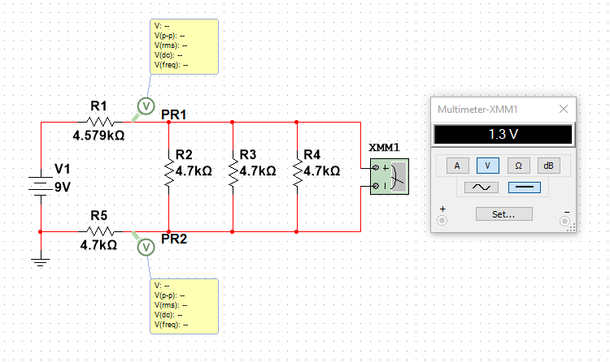
Lab 8-Black Box Design 3
Procedure:
I used 4.7kW resistors as my 3 equal value resistors. This produced the desired output voltage of 1.3V
I then adjusted R1 in the hundredth and thousandth places to get exactly 1.3V
I made my adjusted R1 greater than my original R1 knowing that when R increases so does V

Slide 34
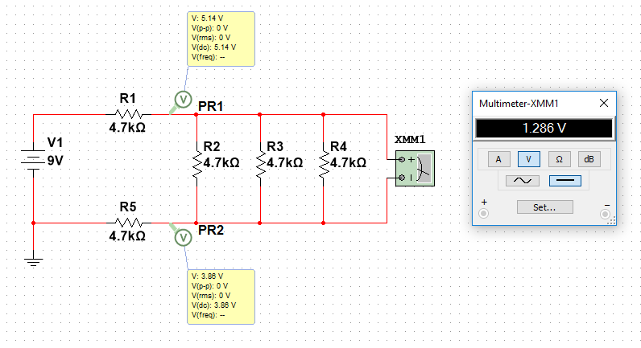

Lab 8-Black Box Design 3
Procedure:
To calculate this in Excel I used the equation $Vx=\frac{rx}{rt}∗Vt$ where Rx is all resistors that the Voltage must pass through before getting voltage that is to be read
I used this to find both VA (PR1) and VB (PR2) and then subtracted VA from VB this gave me the output voltage I wanted to read

Slide 35
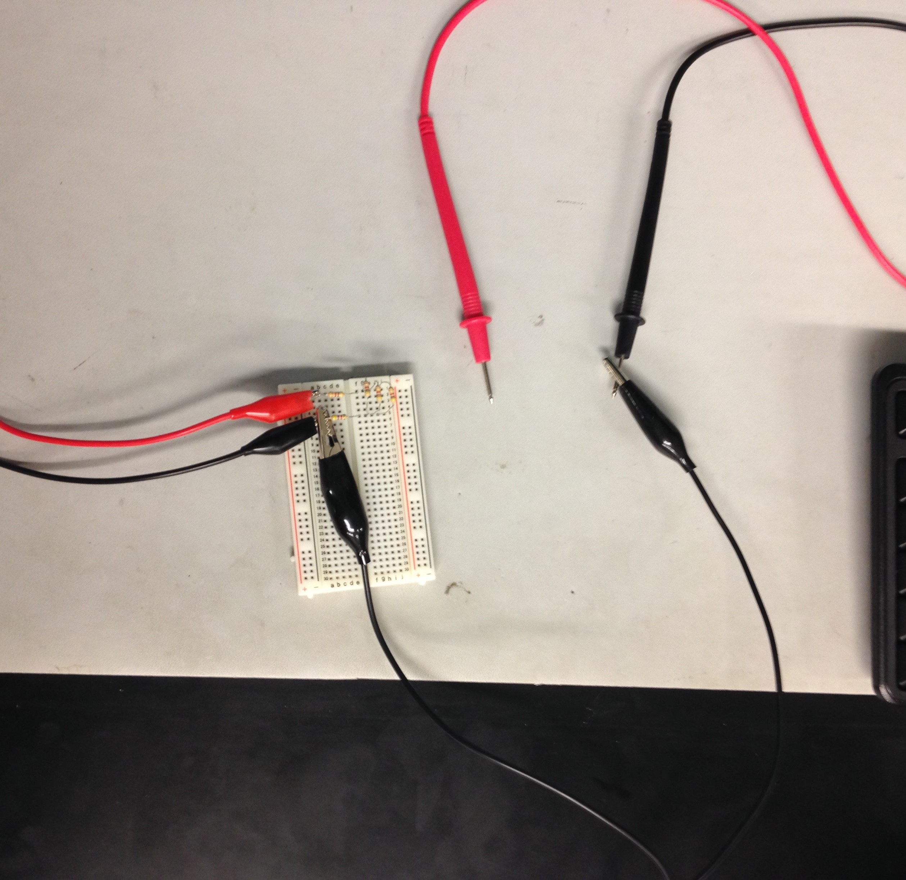
Lab 8-Black Box Design 3
Procedure:
When Salam and I met in the lab we assembled our breadbox with the 4.7kW resistors required
We attached the ground to the same resistor as the negative side of the Elvis II and the negative input end of the digital Multimeter.
This left the positive end of the digital Multimeter free to read each point of the circuit that we needed to

Slide 36
Lab 8-Black Box Design 3
Results and Observations:
Despite us not getting the Elvis II to read exactly 1.3V
Each the measured, calculated, and simulated results corresponded rather surprisingly well to each other in this lab
 | Measured | Calculated | Simulated
V1 = | 8.927 | 9 | 9
VA = | 5.156 | 5.143 | 5.14
VB = | 3.889 | 3.857 | 3.86
VA - VB = | 1.267 | 1.286 | 1.28
(VA - VB) adj = | N/A | 1.30 | 1.30

Slide 37
Lab 10-Series and Parallel Capacitors
Goal:
The purpose of this lab was to learn about series and parallel circuits with capacitors
The tools used were an LCR Meter, 3 standard capacitors (10mF, 22mF, 47mF), Multisim, and Excel
My lab partner was Salem Aldossary and we used bench 6
The date was 4/12/2018

Slide 38
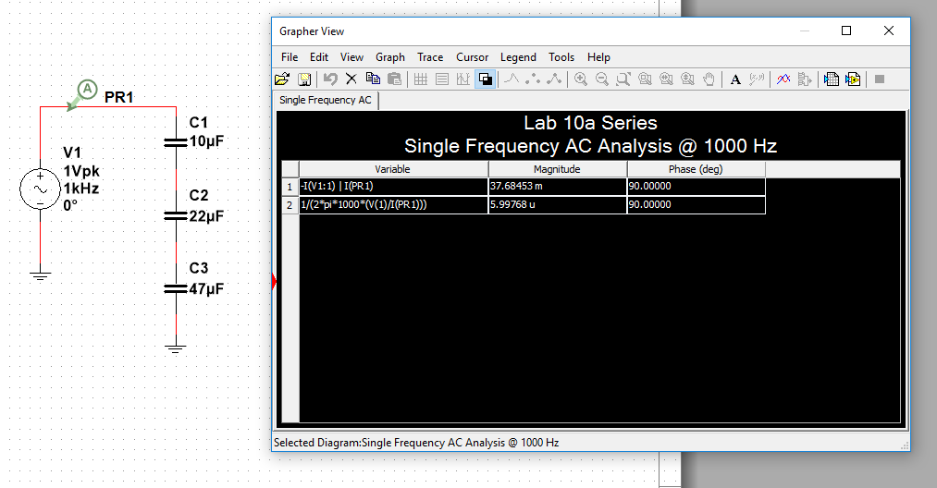

Lab 10-Series and Parallel Capacitors
Procedure:
When reading the capacitance of the circuit I had built in Multisim I used Single Frequency AC in Analyses and Simulation
I set the frequency to 1kHz to correspond to my AC battery and set the output to Magnitude/Phase
I used the equation $Xc=\frac{1}{2πfC}$ and adjusted it algebraically to be $C=\frac{1}{2πf\left(\frac{V}{A}\right)}$

Slide 39
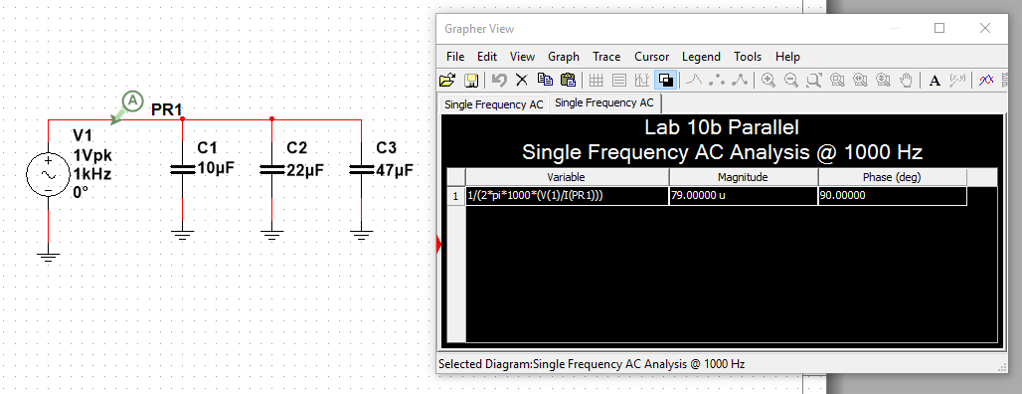
Lab 10-Series and Parallel Capacitors
Procedure:
Doing this for both parallel and series gave me the capacitance of each circuit
To calculate capacitance in Excel I used the reciprocal method for series and addition for parallel, this is opposite to how resistance is calculated

Slide 40
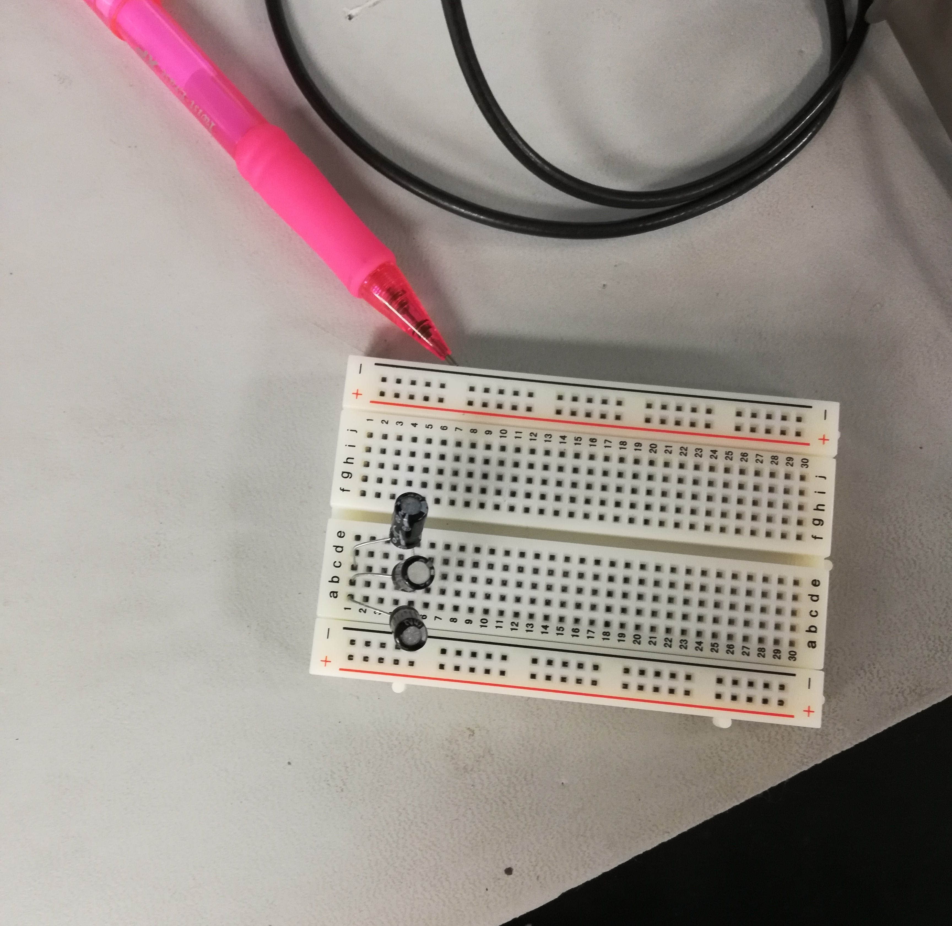
Lab 10-Series and Parallel Capacitors
Procedure:
When in the lab the LCR meter was used to read each capacitor
Then the capacitors were put in the breadbox in both series then parallel configuration
Then the LCR meter was used to read the total capacitance for each circuit

Slide 41
Lab 10-Series and Parallel Capacitors
Results and Observations:
The expected is the excel calculations, the measured is the lab results, and the simulated is the Multisim simulation
When using different mediums the total capacitance was calculated in very different ways
The capacitors were siginificantly smaller than advertised if you consider .00001 to be significant
Series
 | Expected | Measured | Simulated
C1 = | 10.0E-6 | 8.06E-6 | 10.0E-6
C2 = | 22.0E-6 | 19.81E-6 | 22.0E-6
C3 = | 47.0E-6 | 34.0E-6 | 47.0E-6
CT = | 6.0E-6 | 4.90E-6 | 6.0E-6
Parallel
 | Expected | Measured | Simulated
C1 = | 10.0E-6 | 8.06E-6 | 10.0E-6
C2 = | 22.0E-6 | 19.81E-6 | 22.0E-6
C3 = | 47.0E-6 | 34.0E-6 | 47.0E-6
CT = | 79.0E-6 | 61.82E-6 | 79.0E-6

Slide 42
Lab 11-Resistor and Capacitor Circuit
Goal:
The purpose of this lab was to learn about circuits with capacitors and resistors
The tools used were a Digital Multimeter, LCR Meter, Oscilloscope, a function generator an Elvis II, 3 standard capacitors (2.2mF, 1mF, .47mF), 1 1kW resistor, Multisim, and Excel
My lab partner was Salem Aldossary and we used bench 6
The date was 4/12/2018

Slide 43
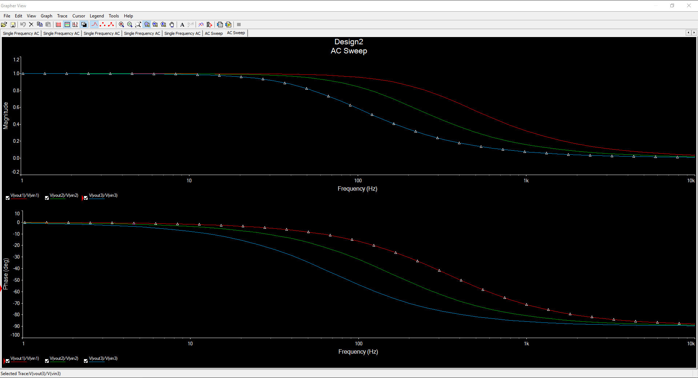
Lab 11-Resistor and Capacitor Circuit
Procedure:
When using Multisim the frequency sweep could be done for each circuit with the different capacitors at the same time by taking the Vout divided by the Vin of each one.

Slide 44
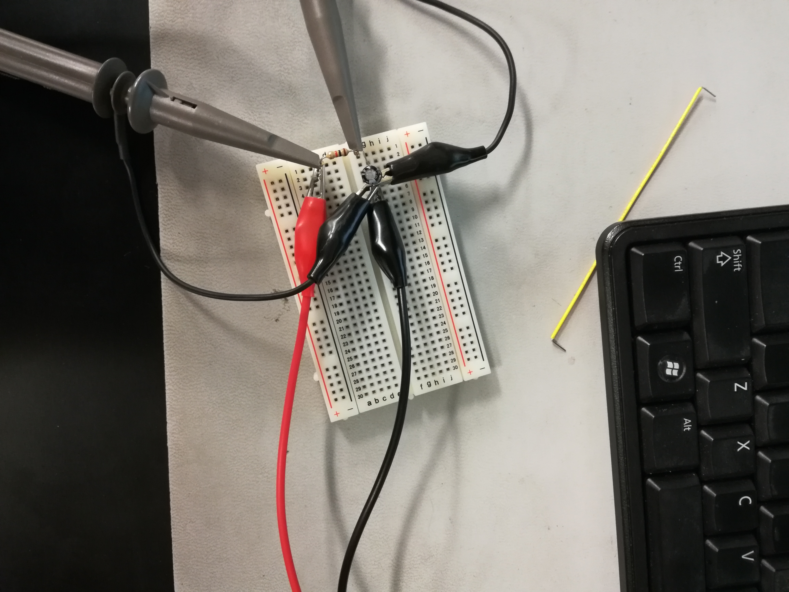
Lab 11-Resistor and Capacitor Circuit
Procedure:
When the capacitor and the resistor were in the breadbox the oscilloscope channels a and b was hooked onto either side of the resistor then to the capacitor opposite side of the resistor
The Frequency Generator was attached to either side of the circuit

Slide 45
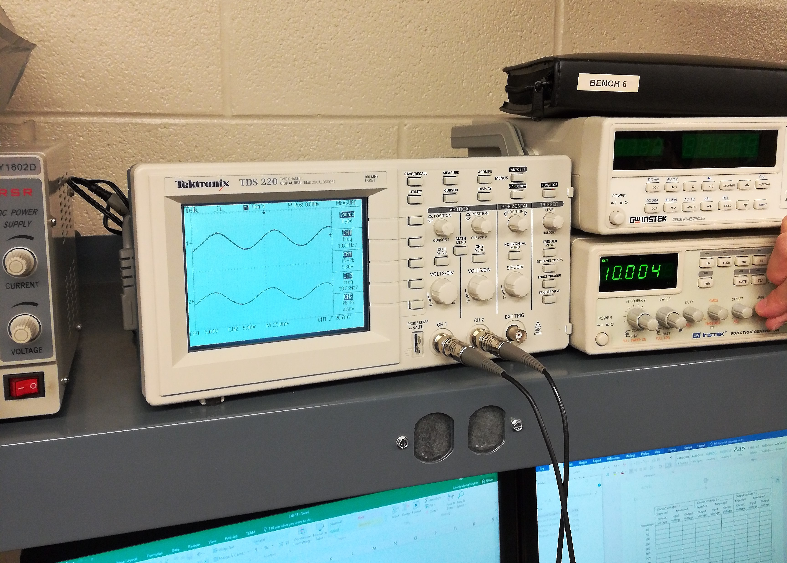
Lab 11-Resistor and Capacitor Circuit
Procedure:
For each capacitor circuit we had to adjust the Frequency Generator to get the readings at each frequency and read the Vin and Vout on the Oscilloscope

Slide 46
Lab 11-Resistor and Capacitor Circuit
Results:
We measured Vin and Vout at 7 different frequencies
Something went wrong when calculating Vout in Multisim so the expected columns should not be trusted for accurate results
 | 0.47uF Capacitor |  |  | 1 uF Capacitor |  |  | 2.2uF Capacitor
 | Expected | Measured |  | Expected | Measured |  | Expected | Measured
Frequency | Vout | Vin | Vout | Vout | Vin | Vout | Vout | Vin | Vout
10 | 999.6E-3 | 2.16 | 1.76 | 998.0E-3 | 2.16 | 1.72 | 990.6E-3 | 2.16 | 1.72
50 | 989.3E-3 | 2.16 | 2.12 | 954.0E-3 | 2.16 | 2.04 | 822.6E-3 | 2.16 | 1.66
100 | 959.1E-3 | 2.16 | 2.04 | 846.7E-3 | 2.16 | 1.88 | 586.1E-3 | 2.12 | 1.16
500 | 560.8E-3 | 2.12 | 1.24 | 303.4E-3 | 2.12 | 0.76 | 143.2E-3 | 2.08 | 0.284
1,000 | 320.7E-3 | 2.12 | 0.76 | 157.2E-3 | 2.12 | 0.384 | 72.2E-3 | 2.12 | 0.148
5,000 | 67.6E-3 | 2.16 | 0.176 | 67.6E-3 | 2.12 | 0.096 | 14.5E-3 | 2.16 | 0.0348
10,000 | 33.8E-3 | 2.12 | 0.096 | 15.9E-3 | 2.12 | 0.052 | 7.2E-3 | 2.12 | 0.0216

Slide 47
Lab 11-Resistor and Capacitor Circuit
Observations:
The Vout we read differed greatly from what we had expected from the Multisim readings the especially when the frequency was lower
Getting results for this was much more difficult to do in the lab than in Multisim

Slide 48
Lab 12-Series and Parallel Inductors
Goal:
The purpose of this lab was to learn about series and parallel circuits with inductors
The tools used were an LCR Meter, 3 standard inductors (1mH, 2.2mH, 4.7mH), Multisim, and Excel
My lab partners were Salem Aldossary and Tung Doan and we used bench 6
The date was 4/26/2018

Slide 49
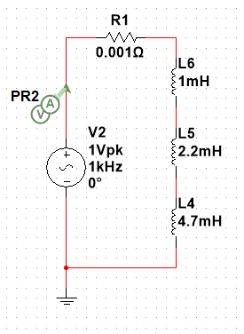
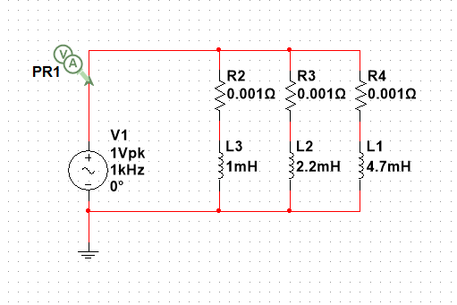

Lab 12-Series and Parallel Inductors
Procedure:
When reading the inductance of the circuit I had built in Multisim I used Single Frequency AC in Analyses and Simulation
I set the frequency to 1kHz to correspond to my AC battery and set the output to Magnitude/Phase
I used the equation $L=\frac{V}{2πfI}$

Slide 50
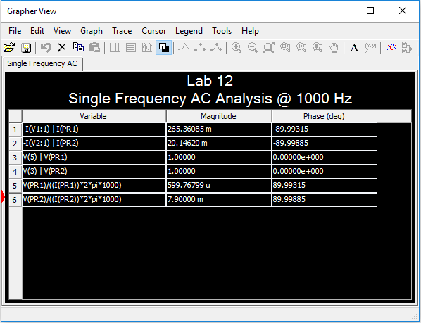

Lab 12-Series and Parallel Inductors
Procedure:
I used the equation $L=\frac{V}{2πfI}$
Doing this for both parallel and series gave me the inductance of each circuit
To calculate inductance in Excel I used the for addition series and reciprocal method for parallel, this is the same to how resistance is calculated

Slide 51
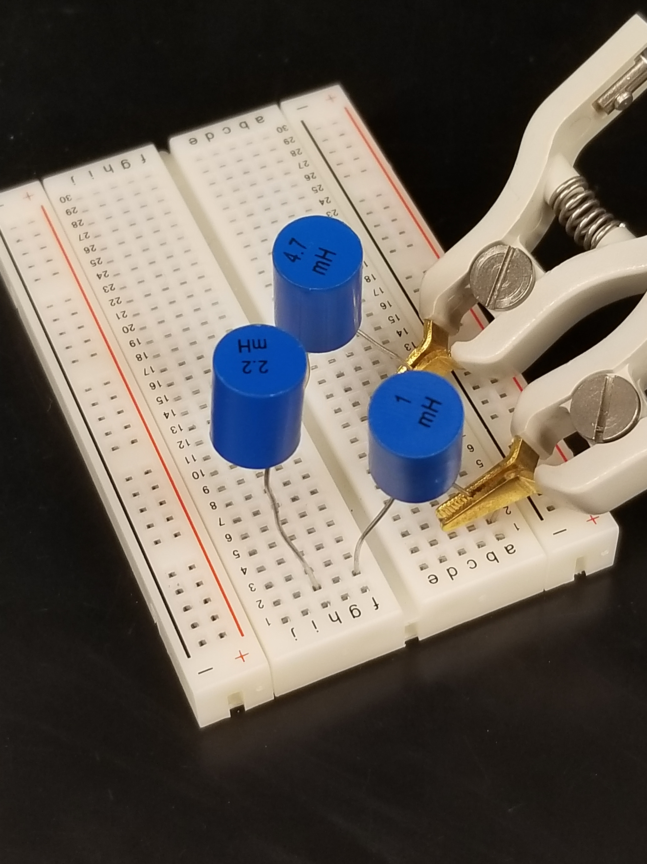
Lab 12-Series and Parallel Inductors
Procedure:
When in the lab the LCR meter was used to read each inductor
Then the inductors were put in the breadbox in both series then parallel configuration
Then the LCR meter was used to read the total inductance for each circuit

Slide 52
Lab 12-Series and Parallel Inductors
Series
 | Expected | Simulated | Measured
L1 = | 1.0E-3 | 1.0E-3 | 1.01E-3
L2 = | 2.2E-3 | 2.2E-3 | 2.17E-3
L3 = | 4.7E-3 | 4.7E-3 | 4.34E-3
LT = | 7.9E-3 | 7.9E-3 | 7.23E-3
Parallel
 | Expected | Simulated | Measured
L1 = | 1.0E-3 | 1.0E-3 | 1.01E-3
L2 = | 2.2E-3 | 2.2E-3 | 2.17E-3
L3 = | 4.7E-3 | 4.7E-3 | 4.34E-3
LT = | 599.8E-6 | 599.8E-6 | 561.6E-6
Results and Observations:
The expected is the excel calculations, the measured is the lab results, and the simulated is the Multisim simulation
When using different mediums the total inductance was calculated in very different ways
The inductors were smaller than advertised which, at this point, is expected

Slide 53
Lab 13-Resistor and Inductor Circuit
The purpose of this lab was to learn about circuits with capacitors and resistors
The tools used were a Digital Multimeter, LCR Meter, Oscilloscope, a function generator an Elvis II, 3 standard capacitors (2.2mF, 1mF, .47mF), 1 1kW resistor, Multisim, and Excel
My lab partners were Salem Aldossary and Tung Doan and we used bench 6
The date was 4/26/2018

Slide 54
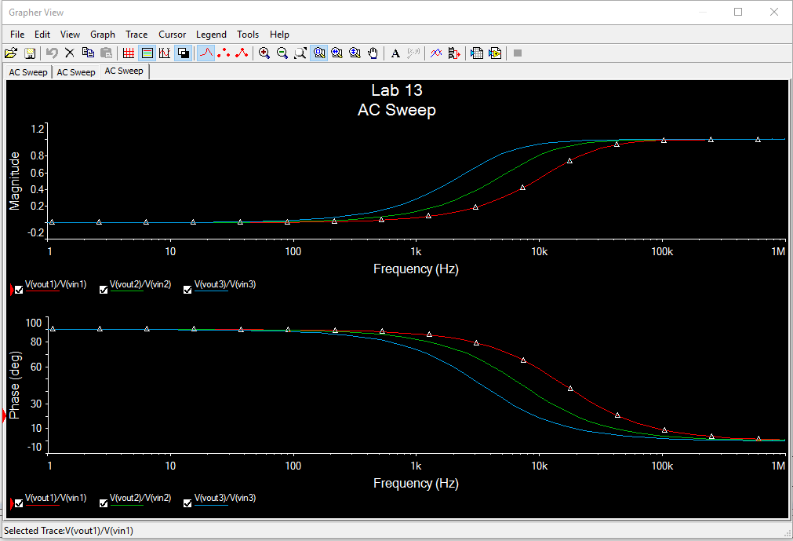
Lab 13-Resistor and Inductor Circuit
Procedure:
When using Multisim the frequency sweep could be done for each circuit with the different inductors at the same time by taking the Vout divided by the Vin of each one.

Slide 55
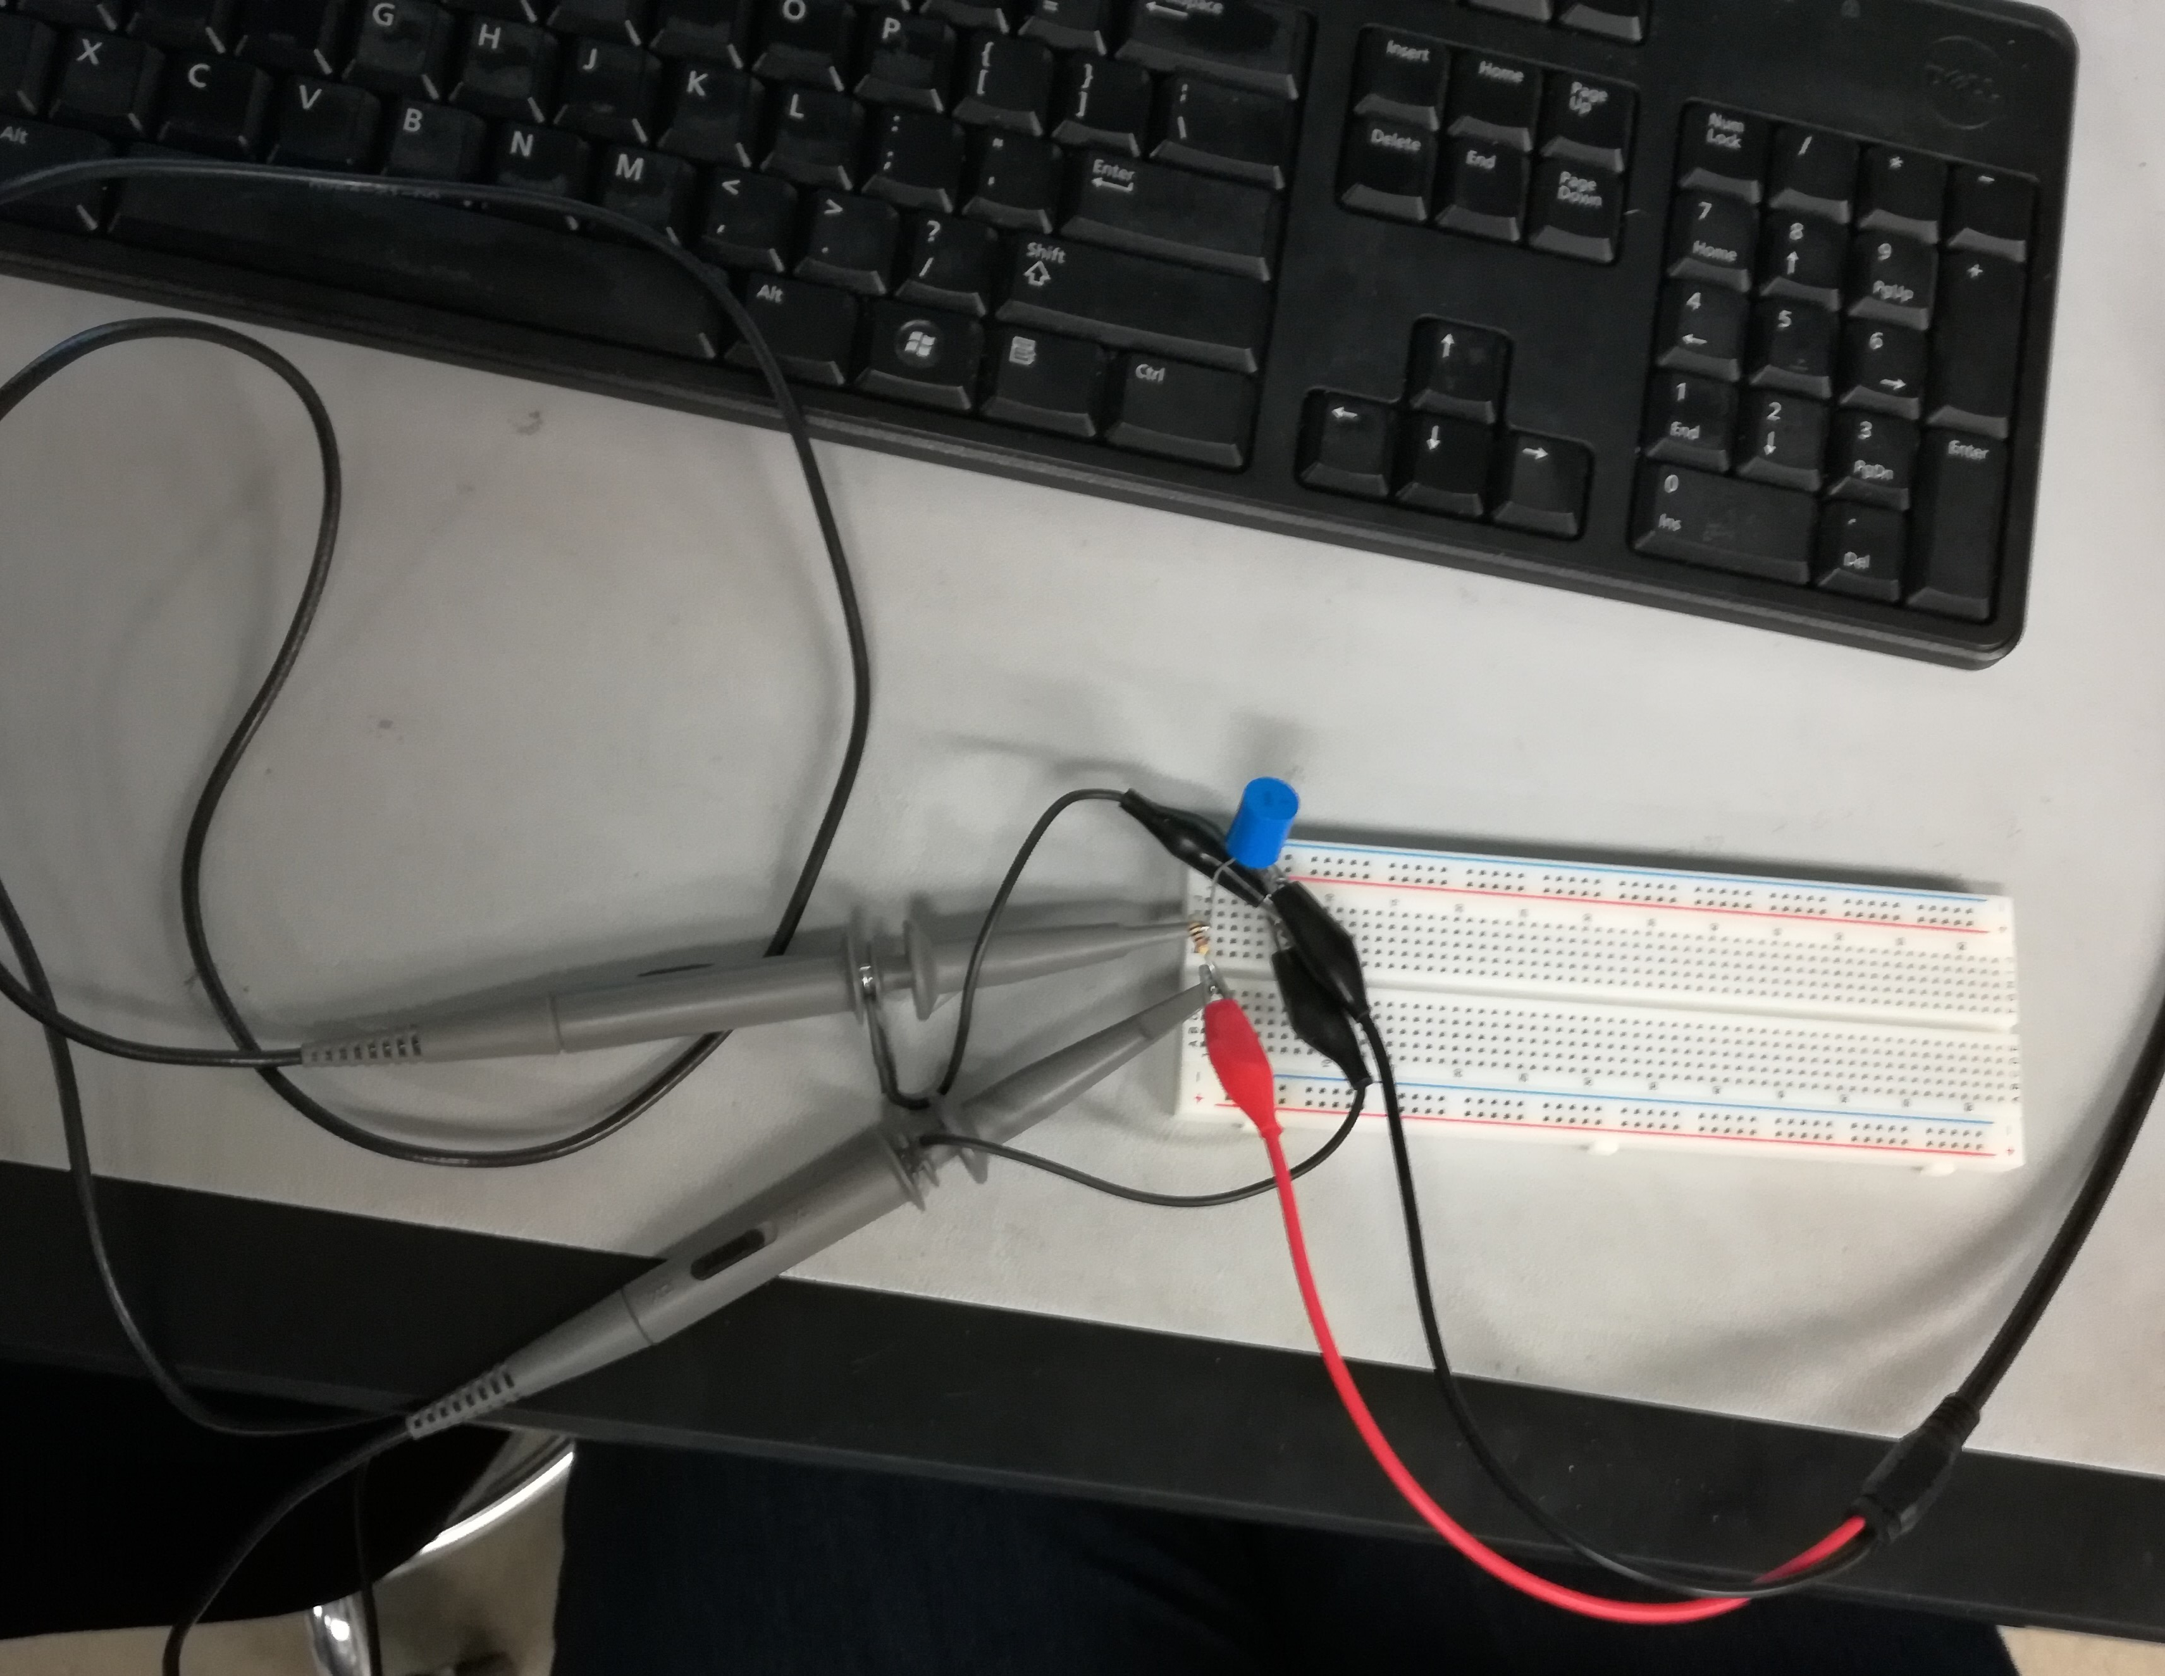
Lab 13-Resistor and Inductor Circuit
Procedure:
When the inductor and the resistor were in the breadbox the oscilloscope channels a and b were hooked onto either side of the resistor then to the capacitor opposite side of the resistor
The Frequency Generator was attached to either side of the circuit

Slide 56
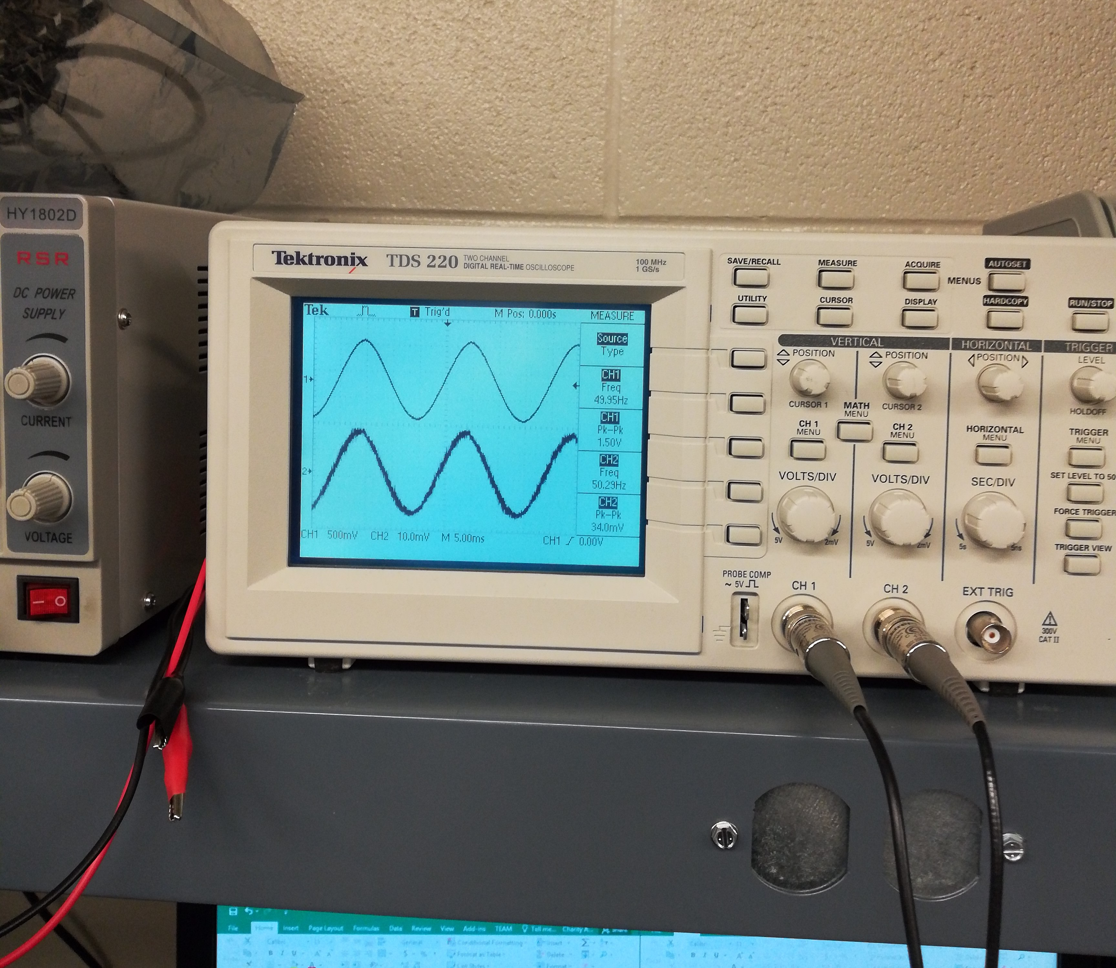
Lab 13-Resistor and Inductor Circuit
Procedure:
For each inductor circuit we had to adjust the Frequency Generator to get the readings at each frequency and read the Vin and Vout on the Oscilloscope

Slide 57
Lab 13-Resistor and Inductor Circuit
Results:
We measured Vin and Vout at 7 different frequencies for each inductor circuit
This lab versus lab 11 were very similar, but this felt much easier as we had a better handle on it
 | 1 mH Inductor |  |  | 2.2 mH Inductor |  |  | 4.7 mH Inductor
 | Expected | Measured |  | Expected | Measured |  | Expected | Measured
Frequency | Vout | Vin | Vout | Vout | Vin | Vout | Vout | Vin | Vout
10 | 628.0E-6 | 1 | 19.6E-3 | 1.4E-3 | 1 | 34.4E-3 | 3.0E-3 | 1 | 74.0E-3
50 | 3.1E-3 | 1 | 22.8E-3 | 6.9E-3 | 1 | 41.8E-3 | 14.8E-3 | 1 | 78.0E-3
100 | 6.3E-3 | 1 | 23.8E-3 | 13.8E-3 | 1 | 43.2E-3 | 29.5E-3 | 1.04 | 80.0E-3
500 | 31.4E-3 | 1.02 | 39.6E-3 | 69.0E-3 | 1 | 76.0E-3 | 146.1E-3 | 1 | 142.0E-3
1,000 | 62.7E-3 | 1 | 64.0E-3 | 135.9E-3 | 1 | 128.0E-3 | 283.2E-3 | 1.04 | 248.0E-3
5,000 | 299.8E-3 | 1.06 | 288.0E-3 | 568.6E-3 | 1.12 | 568.0E-3 | 827.9E-3 | 1.26 | 980.0E-3
10,000 | 532.2E-3 | 1.1 | 528.0E-3 | 810.2E-3 | 1.24 | 960.0E-3 | 947.2E-3 | 1.4 | 1.26

Slide 58
Lab 13-Resistor and Inductor Circuit
Observations:
The Vout we read differed greatly from what we had expected from the Multisim readings the especially when the frequency was lower
Getting results for this was much more difficult to do in the lab than in Multisim

